Slide 1
Feb 18 – Mar 3, 18.0 g dry ice in 150 g of VORANOL 360

Slide 2
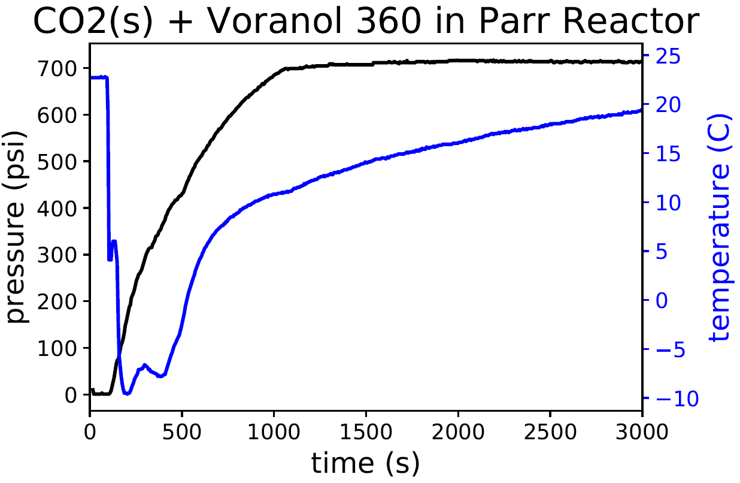
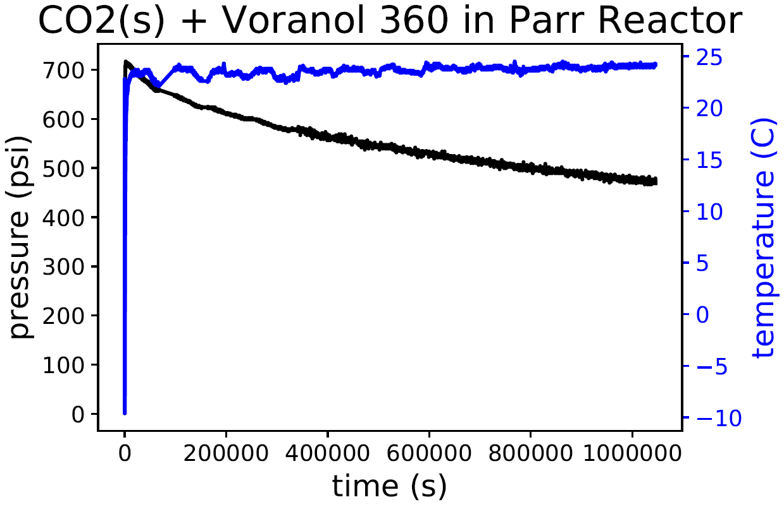
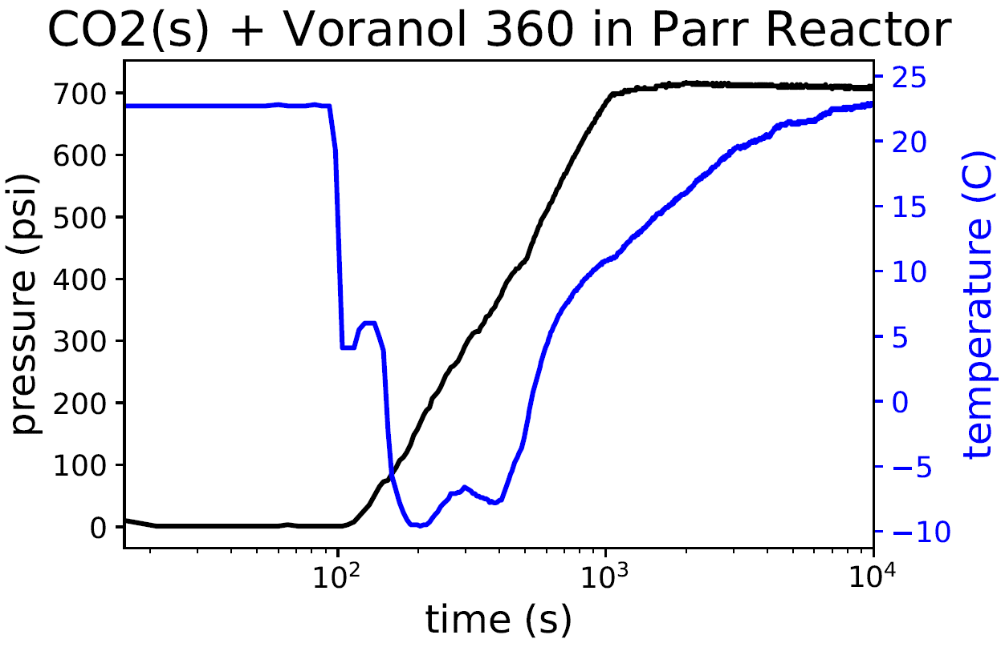
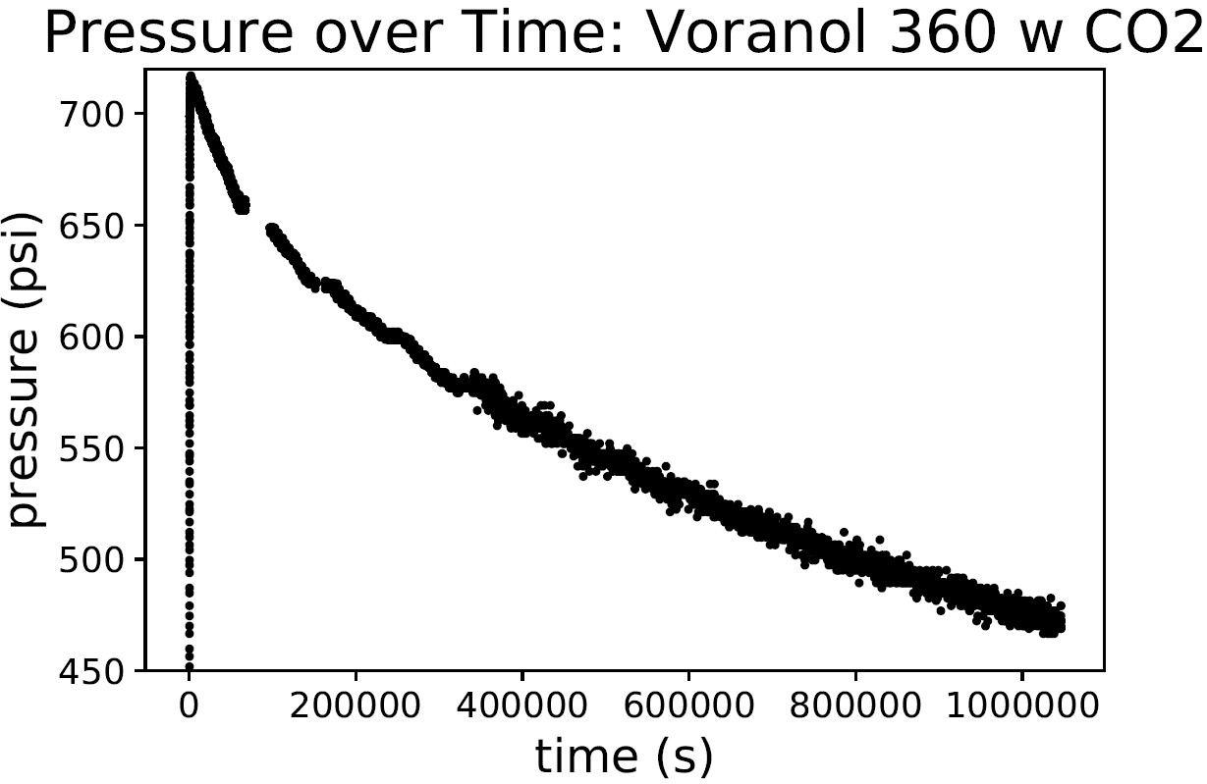

Slide 3
March 6, 18.0 g dry ice, while pumping polyol after 2 weeks of saturation

Slide 4
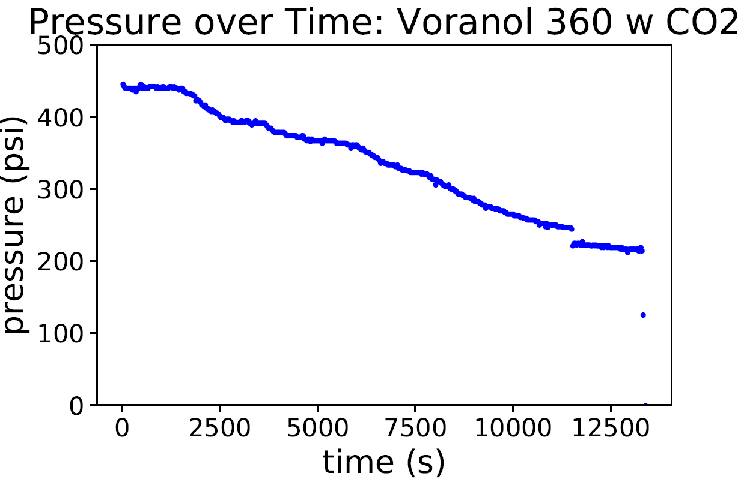

Slide 5
Mar 8 – Mar 11, 37.4 g dry ice

Slide 6
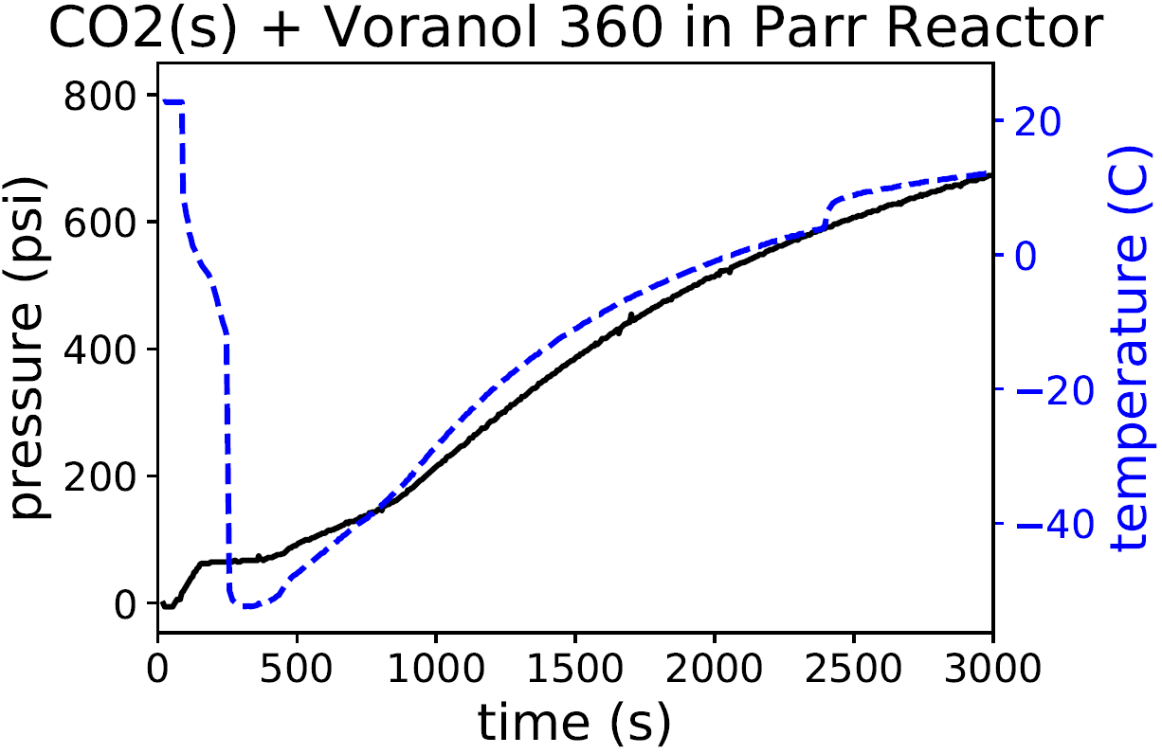
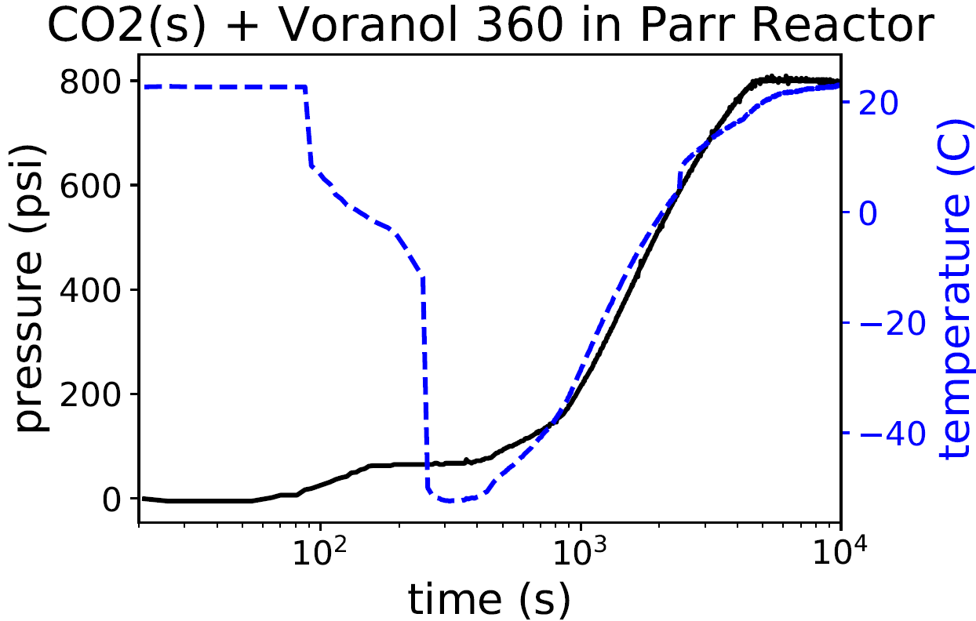
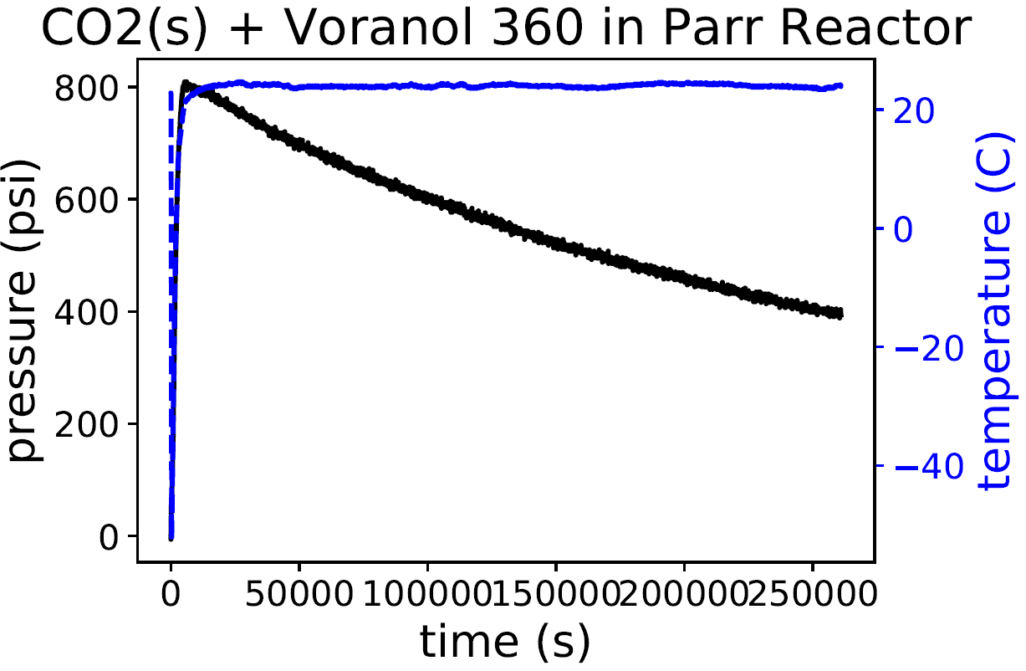
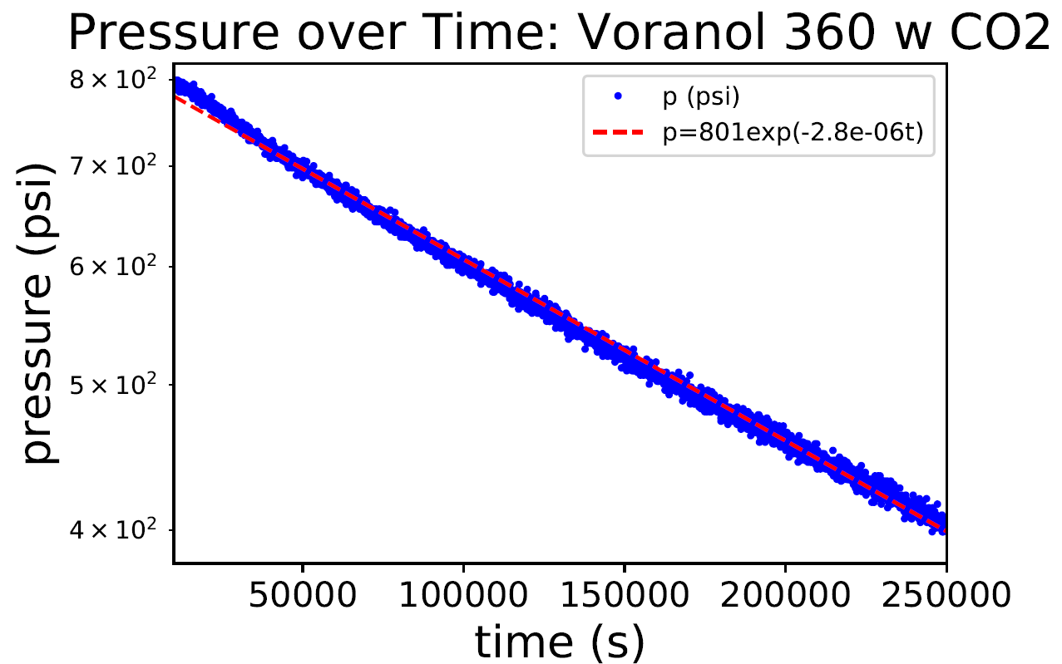

Slide 7
Mar 12-13, 31.9 g dry ice
Reassembled fixture for pressure transducer to be tighter at the base

Slide 8
